Slide 1
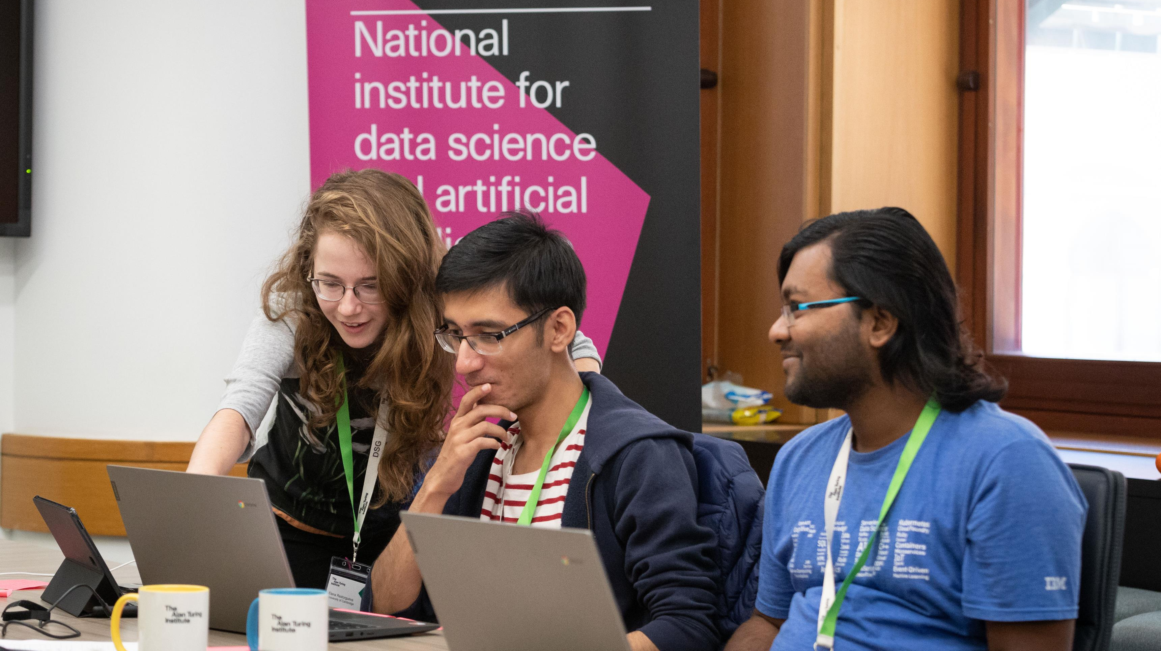
Facilitator Training Day 2
The Alan Turing Institute Data Study Group

Slide 2
What does success look like?

Slide 3
Markers of success…
Solving the Challenge
A report that documents EVERYTHING!! Even what didn’t work and explaining why. It should also document why each avenue of analysis was explored.
Delivery of the presentation on Friday
Everyone who takes part enjoys themselves and has good positive memories of their time at the Turing
-Ideally they’ve learnt something new
- Or applied an idea to new data
-For the company to be happy we want the best data science solution and the participants will be happy if they are delivering that solution.

Slide 4
What is the minimum viable success? If things go really wrong, what do we need to really focus on?
Delivering the report on time
Deliver a technical solution
If the challenge is poorly defined, give justification for the technical solution that was chosen.
Remember; A challenge is never perfectly posed. They are often qualitative questions. Reframing them into a statistical challenge, or into a specific scientific formulation is a huge deliverable. Use the expertise from the representatives from our industry partners

Slide 5
What is the optimal success?
If things are going super well, what do we do then!?
Transforming state of the art of data science within the company!
What does this mean?!
A scientific formulation of the challenge question. Refine very specifically what needs to be done and exactly how that question can be answered.
Insights to the organisation that allow them to change how they run, or how the provide knowledge based on this data
Developing a new process, a new direction for the company.
All of these high level successes build on the other deliverables:
Report on time
Successful collaboration
Note that many of these points are built on clear communication, and clear communication to key stakeholders. Unlikely to work when only looking from a specific (eg: technical point of view)
Remember that it is often very difficult to share knowledge between academic scientists (even BETWEEN academic disciplines!) so a key deliverable is to communicate that information to our industry partners.

Slide 6
The New and Improved DSG PI
- Due to inconsistencies of translation to paper the effort committed by past participants has in cases never been made publicly available (via the end report)
-Starting in December 2019, the DSG PIs will be present throughout the entire week, and will take on the responsibility of taking the report at the end of DSG week
-Their role during the week will be to monitor the quality of the work produced and provide domain expert specific guidance to ensure that the quality of work undertaken is of a calibre that would be amenable to submission to a peer-reviewed journal with minimal additional work following the DSG week.

Slide 7
What will this mean for you?
It should have no impact on the roles and responsibilities of the facilitators as previously described.
In effect, there is just an additional person you can use to support you, and the rest of the DSG project team during the week. No one has any ideas about what to do = get the DSG-PI to offer some suggestions. No one is writing in the HackMD = ask the PI to be the bad guy and talk to the team. A lot of new material added and it’s not your expertise = ask the PI to review it in real time.
The PI is not in the room to undermine you, they know they are there to support you and everyone else. Use them, or don’t, as needs be. And if your PI isn’t being as helpful as you need them to be, or is getting a little over-zealous (because it’s not their job to tell you what to do assuming people are coming up with sensible ideas), then just speak to your friendly DSG team.

Slide 8
Reports
Very Useful Report Template Below!!!
https://hackmd.io/OQ6tj3lrQzapB0HXTxoPPw

Slide 9

The Key to Reports…
Document everything as you work!!!

Slide 10
Report Writing Checklist
Executive Summary
Data scientific problem formulation/ Methodological approach
Data Summary and exploratory data analysis
Sections about different approaches- experiments & advanced methods
Limitations
Future work

Slide 11
DSG report – technicalities
Make sure all files to compile the report are saved as outputs
Tables/figures: make sure these have a complete legend or row/col headers
Attach a full caption/description (txt file) of what the tables figure show
In safe haven: make sure to put these in the correct output folder for egress
Regularly use Gitlab to sub-version your code
Commit your code at important checkpoints, include descriptive labels
Make sure most recent code produces most recent figures, or include version
Day 1: agree on shared folder & project structure – VM are shared
If working across teams: agree on conditionalities, interfaces and timelines
Example: data cleaning, everyone should agree format & who does it when

Slide 12
Friday Presentations
20 minutes roughly, 3-4 presenters
Overview of data & challenge
Results & Limitations
Approaches (and why you chose them)
Future work

Slide 13
Communication via Slack
Communications via slack
https://turingdsg.slack.com
Everyone will be invited on Monday morning after the presentations.
Due to the confidentiality of some of the challenges, it is imperative that no discussions on the actual challenge data, code or insights be conducted on the Slack channel.
Do use the Slack channel to:
organise in your groups
ask the executive team for additional help including IT support
share interesting resources
ask someone to come and find you to discuss a particular challenge question in person
People coming from different teams is totally fine but do not discuss the challenges in any part of the Slack workspace (including private channels and direct messages).
Also use Slack to build an ongoing Turing DSG participant community that continues following the event itself.
Be aware that previous participants will be in the Slack channel already!
This is supposed to be a good thing! You can share opportunities!
Everyone is able to leave the channel at any time they wish.

Slide 14
The Slack Channels
Other useful channels:
dec19-facilitators private channel for delicate discussions
presentation-qs for questions about the presentation
report-qs for questions about the reports
introductions to share a little more about yourself and virtually meet other participants
requests for...well...requests!
help for help!
social to help coordinate any breaks from the work
opportunities to share other events or other opportunities that DSG community members may be interested in
pictures to share pictures if all people in the photographs consent to the picture being shared
There will be channels for each of the challenges:
dec19-WWF
dec19-TNA
dec19-DstlAnthrax
dec19-DstlConfocal
dec19-SenSat
dec19-AgileDatum

Slide 15
DSG report – recommended workflow
Day 1 – brainstorming session & complete record of ideas (section 2!)
Which high-level data scientific approaches address which questions?
e.g., supervised learning, or model structure inference within predictive model
Is the data sufficient to address all questions? Or, only surrogates (defined as …)
common issues: data only observational, no causality; no control group
Day 2-4 – everyone should keep a lab book!
Use hackMD for individual notes of ideas, experiments, findings!
Day 3-4 – start filling in (joint) report as you go along
Well-structured & complete report results in a great presentation on Friday!
Regularly review each other’s contributions – is more detail needed?

Slide 16
HackMD
Everyone should have their own HackMD lab book for individual notes of ideas, experiments, findings.
These should all be combined at the end of group work to help create the report.

Slide 17
Kan Ban Boards
Past facilitators have found using this method really useful, we recommend you try it!

Slide 18
Kan Ban Boards
Time is of the essence to organise and visualise what everyone is working on.
Kanban Cards – This is the visual representation of tasks. Each card contains information about the task and its status such as deadline, assignee, description, etc.
Kanban Columns – Each column on the board represents a different stage of your workflow. The cards go through the workflow until their full completion.
Work-in-Progress Limits – They restrict the maximum amount of tasks in the different stages of the workflow. Limiting WIP allows you to finish work items faster, by helping your team to focus only on current tasks.

Slide 19


KAN BAN Suggested Workflow
To do
Development
Documentation
Completed
NO MORE THAN 1 NOTE PER PERSON IN THIS COLOUMB
Recorded reasoning
1 note per idea
Pick up a new to do
Recorded outcome
Can only be moved across when someone becomes the owner and adds their name
Remains here during exploratory work

Slide 20
Lessons Learned

Slide 21
No Access to Data!
-Stay cool
-Split up what tasks you can to move forwards
-Don’t wait until that particular problem is solved keep moving, time is of the essence

Slide 22
Ensure all ideas are heard in the brain storming session
-As facilitator share your ideas last
-Don’t let individuals dominate the conversation
-Encourage input from quieter members

Slide 23
Encourage working in pairs
-If possible, encourage working in 2’s or 3’s
-While one person is coding the other can document what they are doing
-It’s a great tactic is ensure everything is documented

Slide 24
Differences in ideas
-You may encounter individuals who don’t want to work on an idea
-Remind them this isn’t effective collaboration
-Organizers and facilitators must try and set the tone that this isn’t ok

Slide 25
Bored Participants
-Build a positive atmosphere as best you can
-Emphasize this is a collaborative environment
-Investigate what the issue is

Slide 26
Lunch

Slide 27
Folder Structure
Please everyone log in and show off your folder structures…
REMEMER EVERYTHING MUST BE DOCUMENTED
‘Outputs’ > ‘report’ ‘code’ ‘images’ ‘data’ ‘presentation’
By the end of today everyone should have their folder structures prepared ☺

Slide 28
Common Access Problems
Foreign numbers = Be aware that foreign numbers can sometimes cause problems so if you suspect this put it on GitHub ☺
Foreign Keyboards = We have a small number of chrome books that participants may be able to use.

Slide 29
How to communicate tech problems to the team
Monday can sometimes be a bit crazy!
Log it on GitHub
Or Slack
And bear with us ☺

Slide 30
Finally……
There will be a social activity on Monday evening
And don’t forget to suggest a trip to the pub on Friday

